Slide 1

MINOR PROJECT
10101043494
AI SMART KNOWLEDGE MANAGEMENT PLATFORM
Project ID | M2_CE_042
Enrollment No | 2402030430064, 2402030430024, 2402030430010
Name | Shah Prem JigneshKumar Shah Jeet MehulBhai Shah Jash PriteshKumar
Branch | B.Tech (C.E)
Guide Name | Prof. Kruti Sheth

Slide 2
Index
Introduction
Background and Motivation
Relevance and Importance
Literature review
Research Gap
Objectives
Required Tools and Technology
Method/ Approach
System architecture
Result
Future Work/Scope
Conclusion
Refrences
10-09-2025
2

Slide 3
Introduction
AI SMART KNOWLEDGE MANAGEMENT PLATFORM
Problem: Knowledge is scattered across PDFs, research papers, videos, documents, notes, images, spreadsheets, and web content, making it difficult to find, organize, and understand information. Solution: An AI-powered Knowledge Workspace that stores all your knowledge, understands uploaded content, provides AI-powered search, generates summaries, quizzes, and flashcards, and supports interactive conversations with documents

Slide 4
Background and Motivation
Background
Current challenges: large unorganized information volume , repetitive document searching , and time – consuming manual note creation . No unified AI workspace exists , and existing tools offer limited document understanding.
Motivation
Build a Personal AI Research Assistant , AI Knowledge Manager , Learning Companion , and Intelligent Search Engine — inspired by Google AI Studio , Note book LM , Chat GPT, Perplexity AI , and Microsoft Copilot.

Slide 5
Relevance and Importance
Relevance
Provides a centralized AI-powered platform to manage and understand diverse digital information. Helps users search, summarize, organize, and interact with their documents and knowledge efficiently. Combines AI to provide relevant and source-based answers.Useful for students, researchers, professionals, and organizations for improving productivity and learning.
Importance
AI-powered knowledge management is reshaping how individuals and organizations interact with information. The growing demand for intelligent productivity tools reflects a need for systems that not only store content but actively understand and assist users. This platform addresses that demand by unifying search, learning, and document intelligence in a single workspace.

Slide 6
Literature Review
Google AI Studio provides a platform to interact with AI models, test prompts, and work with different types of inputs.
NotebookLM allows users to upload documents and ask questions, generate summaries, quizzes, and study materials from their sources.
Google Gemini provides text and image understanding, question answering, summarization, and content generation.
ChatGPT provides conversational interaction and helps users understand and generate content.
Traditional document systems mainly focus on storing and organizing files, with limited interactive learning features.
However, the set tools combine knowledge management, document intelligence, AI search , long term memory, and multi format understanding into a single unified work space.

Slide 7
Literature Review
Rank | Ref. No. | Paper | Api/Technology | Why It Best Suits Your Project | How You Can Use IT(Findings) | Refrences papers link
1 | https://ray.yorksj.ac.uk/id/eprint/9863/1/06.pdf | Domain Pro Chatbot: A Multi-Domain AI Career Advisor System | Google Gemini API, Python, Flask, SQLite | Strongest practical match: a lightweight, self-hosted chatbot using Gemini, user accounts, stored conversations, and minimal infrastructure. | Use as the main implementation reference for Gemini API integration, authentication, chat storage, and a web-based chatbot architecture. | https://www.ijirset.com/upload/2024/april/33_Personalized.pdf
2 | https://journals.ekb.eg/ | Implementation of the Gemini LLM in Android-Based Chatbot Application Development | Gemini API key, Android | Directly studies implementation of a Gemini API key in a chatbot and verifies whether the application can use Gemini functionality successfully. | Cite it to justify that your system can rely on a hosted Gemini model rather than training an LLM. Adapt the Android implementation concept to your web application. | https://e-journal.gomit.id/jsseis/article/view/70
3 | https://zuscholars.zu.ac.ae/cgi/viewcontent.cgi?article=6907&context=works | Personalized Chatbot Optimization Using OpenAI | OpenAI API, user-oriented chatbot personalization | Direct match for your personalization goal: an application-level chatbot using an external API. The exact published title is Personalized Chatbot Optimization Using Open AI developer android | Use in the literature review to show that personalization can be handled through user context and prompt design, without claiming RAG. | https://ijcrt.org/viewpaperforall.php?paper=IJCRT2609024
4 | Developer android | AI Chatbot Using the MERN Stack and OpenAI API | MongoDB, Express.js, React, Node.js, OpenAI API | Relevant full-stack example: web interface, backend server, database, and LLM API communication. Related implementations use the MERN stack with OpenAI to create full-stack chatbot applications. | Use it for your system-design chapter: frontend â†’ backend â†’ LLM API â†’ generated response â†’ chat UI. | https://ijrpr.com/uploads/V6ISSUE7/IJRPR50882.pdf
5 | Developer android | Voice Command Chatbot with ChatGPT Integration | Python, Flask, OpenAI API, Gemini API, Google TTS / pyttsx3 | Shows a chatbot that integrates external LLM APIs through a backend service; the paper lists Python, Flask, OpenAI API, Gemini API, and text-to-speech technologies. | Use it to explain secure server-side API calling, prompt construction, and future work such as voice input/output. Do not list voice as a current feature unless you have implemented it. | https://www.ijsdr.org/papers/IJSDR2511109.pdf

Slide 8
Rank | Ref. No. | Paper | Api/Technology | Why It Best Suits Your Project | How You Can Use IT(Findings) | Research paper Link
6 | Developer android | Mind Mate: An AI-Powered Chatbot for Mental Health Support | Gemini API, web/mobile chatbot backend | Uses Gemini API to provide user-facing, personalized conversational support. | Use it to support the claim that Gemini can generate context-sensitive and personalized chatbot responses. Clearly state that your project is for knowledge management, not medical or mental-health advice. | https://ijrpr.com/uploads/V5ISSUE5/IJRPR27476.pdf
7 | google | GENIE: Intelligent Chatbot | MERN stack, OpenAI API, GPT-based generation | A web application built using MERN that integrates OpenAI APIs for text and code generation. | Use it as an additional full-stack reference for responsive UI, API routing, environment-variable management, and calling an external LLM from a backend. | https://www.ijcrt.org/papers/IJCRT24A5643.pdf
8 | Developer android | Selection of Large Language Model for Development of Interactive Chat Bot for SaaS Solutions | ChatGPT/OpenAI API, Cohere API, Llama API comparison | Useful for explaining why a project uses a hosted LLM API instead of building a model from scratch. The study evaluates three API-accessible models and recommends ChatGPT based on speed, cost-effectiveness, and relevance. Developer android | Use in the methodology or technology-selection section to compare Gemini, OpenAI, Cohere, and other LLM APIs by cost, response quality, availability, and ease of integration. | 1890+Jurnal+IJSET+Lianawati+Suwito.pdf
9 | journal.umgo.ac | Cooking and Food Information Chatbot System Using GPT-3 | GPT-3, OpenAI API | A domain-specific chatbot that uses GPT-3 to provide food-related information and personalized recommendations. The Cook Pal chatbot was developed to support healthy-eating information and dietary concerns. Developer android | Use it to show that a general-purpose LLM API can be adapted to a specialized domain by using structured prompts and user inputs. Your specialized domain is personal and organizational knowledge access. | https://rjwave.org/jaafr/papers/JAAFR26A5269.pdf
10 | journal.eng.unila.ac | Thinking Assistants: LLM-Based Conversational Assistants | GPT-4, OpenAI Streaming API | Relevant for responsive multi-turn conversation, interactive assistant behavior, and user-facing chat design. | Use it when discussing chat history, conversation flow, streaming responses, usability, and future enhancement of the chatbot interface. | https://www.ijisrt.com/assets/upload/files/IJISRT25SEP264.pdf

Slide 9
Research Gap
Previous studies have shown that external Large Language Model APIs, including Gemini and OpenAI APIs, can be integrated into web and mobile applications to provide interactive, contextual, and personalized chatbot responses. Existing systems commonly focus on individual domains such as customer service, career guidance, mental-health support, website assistance, or library services. However, many do not combine API-based personalized chat interaction with a general-purpose knowledge management environment that supports secure user access, centralized document organization, categorization, document-update tracking, and unified information access. The proposed Smart Knowledge Management System addresses this integration gap by providing a full-stack platform that combines document management and secure knowledge sharing with an external API-based personalized chatbot. The current system uses API-key integration and prompt-based interaction, without implementing RAG, vector databases, Lang Chain, embeddings, or a custom NLP pipeline.

Slide 10
Objectives
Objectives
Primary objectives focus on building an AI - powered knowledge workspace that supports multiple document formats, implements semantic search, enables AI conversation switch documents, and integrates YouTube knowledge extraction . Secondary objectives include generating summaries, creating flash cards, building quizzes, maintaining long term workspace memory, and providing source AI-responses .

Slide 11
Required Tools and Technology
Required Tools and Technology
Frontend Backend Database AI Integration
Next.js 15 FastAPI MongoDB Google Gemini API
React.js Python Google Generative AI SDK
TypeScript Uvicorn
Tailwind CSS Pydantic
shadcn/ui JWT Authentication
DEPARTMENT OF COMPUTER ENGINEERING

Slide 12
Method/ Approach
Methodology
1.Upload document or video
2.Content extraction from files
3.Text processing and cleaning
4.Embedding generation for semantic representation
5.Store embeddings in vector database
6.Semantic indexing for retrieval
7.AI retrieval using Retrieval Augmented Generation (RAG)
8.Response generation with accurate

Slide 13
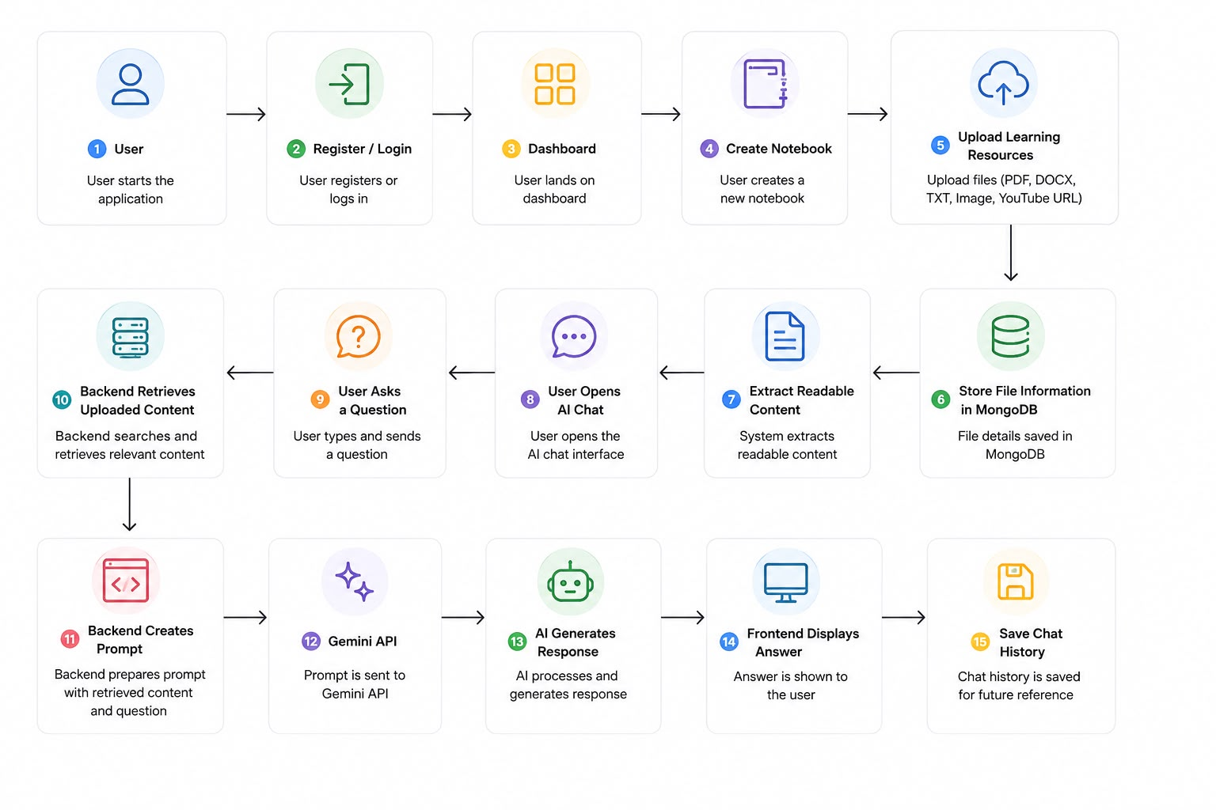
System Architecture
DEPARTMENT OF COMPUTER ENGINEERING
13
10-09-2025

Slide 14
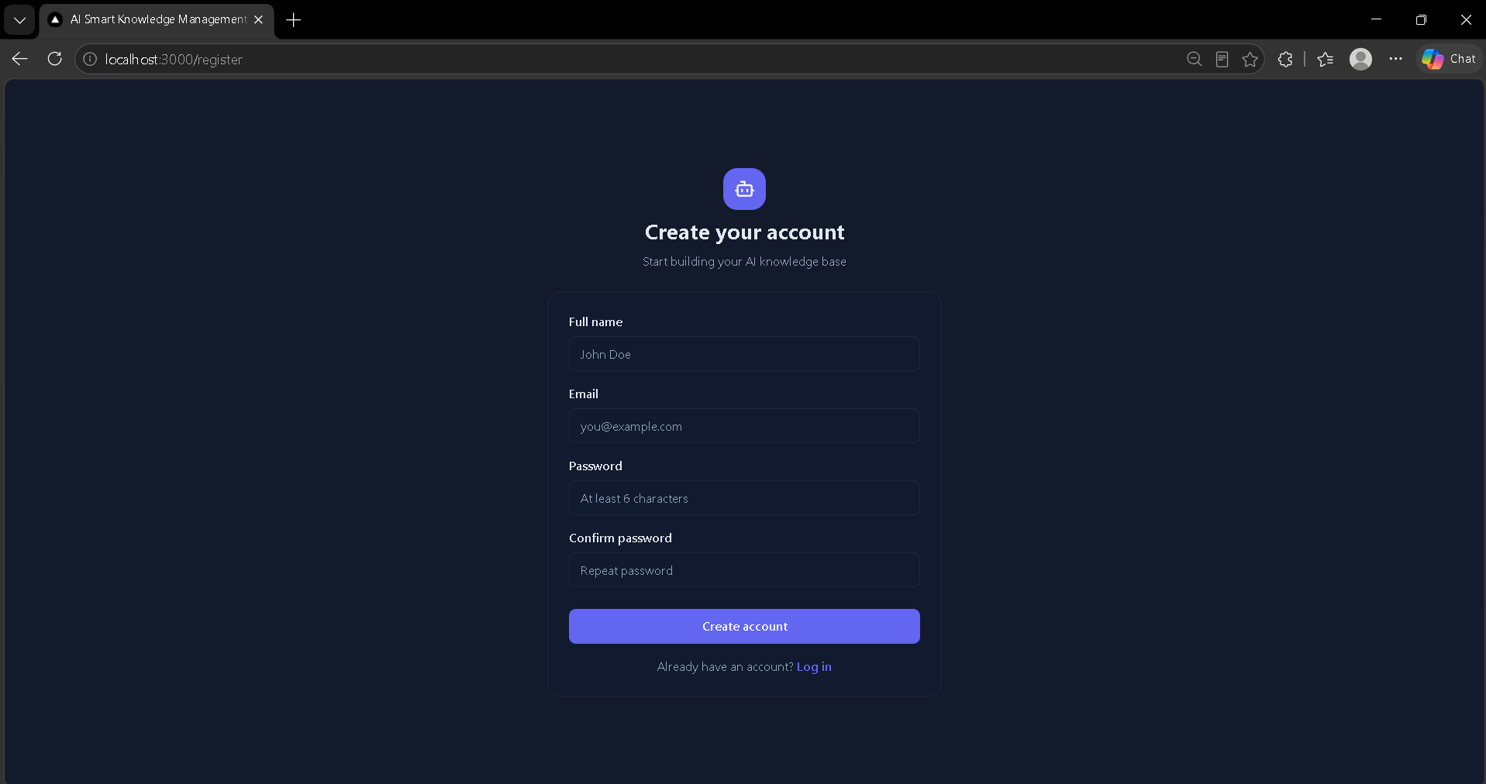
Result
Register page

Slide 15
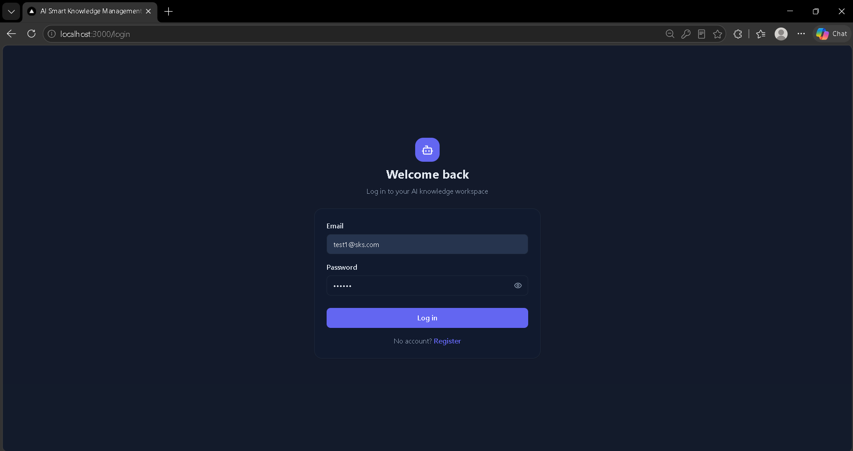
Result
Login page

Slide 16
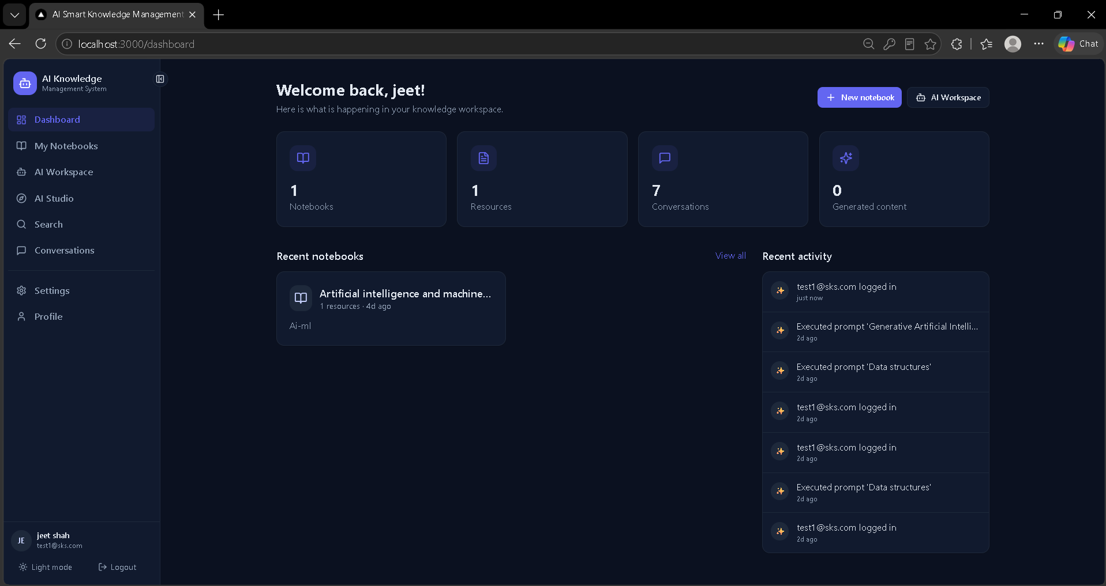
Result
Dashboard

Slide 17
Future work /Scope
Add document version tracking so users can compare updatedresources.
Add resource-level permissions for shared organizationalnotebooks.
Introduce richer source references in the chat interface so userscan quickly inspect the original material.
Add multilingual interaction for regional and internationaleducational use.
Provide export of summaries, quizzes, and flashcards intoprintable study formats.
Add analytics showing which notebooks and learning activitiesare used most often.
Develop automated regression tests for resource processing andchat workflows.

Slide 18
Conclusion
This project introduces a Smart Knowledge Management System that centralizes scattered learning materials into a single interactive platform. By smoothly integrating the Gemini API and database storage into a practical workflow, it helps users actively learn from their resources rather than just storing them. As a straightforward academic prototype, it proves that AI works best when embedded directly into everyday tasks. Moving forward, future work will focus on real-world user testing, stronger privacy controls, better resource processing, and clearer source tracking to fully measure and expand the system's impact.

Slide 19
Refrences
Refrences
Google. Gemini API / Google AI for Developer. Website: https://ai.google.dev
Perplexity AI. Perplexity Help Center⁠ Relevant to your AI-powered search, web retrieval , conversational answers. Website: https://www.perplexity.ai
Google, “Google AI Studio,” Google AI for Developers, 2026. [Online]. Available: https://aistudio.google.com/
Google, “NotebookLM,” Google, 2026. [Online]. Available: https://notebooklm.google/
Google, “Gemini API documentation,” Google AI for Developers, 2026. [Online]. Available: https://ai.google.dev/gemini-api/docs
Gemini Team, “Gemini: A family of highly capable multimodal models,” arXiv preprint arXiv:2312.11805, 2023.

Slide 20
Thank you

